Slide 1
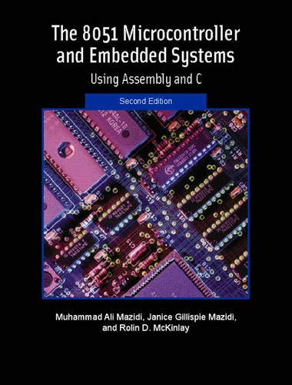
THE 8051
MICROCONTROLLER & Embedded Systems
Muhammad Ali Mazidi, Janice Mazidi
& Rolin McKinlay

Slide 2
THE 8051
MICROCONTROLLERS
Chapter 1

Slide 3
Objectives
Upon completion of this chapter, you will be able to:
>> Compare and contrast microprocessors and microcontrollers
>> Describe the advantages of microcontrollers for some applications
>> Explain the concept of embedded systems
>> Discuss criteria for considering a microcontroller
>> Explain the variations of speed, packaging, memory, and cost per unit and how these affect choosing a microcontroller
>> Compare and contrast the various members of the 8051 family
>> Compare 8051 microcontrollers offered by various manufacturers

Slide 4
Objectives
A discussion of the role and importance of microcontrollers in everyday life,
Section 1.1, the criteria to consider in choosing a microcontroller, as well as the use of microcontrollers in the embedded market,
Section 1.2, various members of the 8051 family such as the 8052 and 8031, and their features
In addition, the various versions of the 8051 such as the 8751, AT89C51, and DS5000

Slide 5
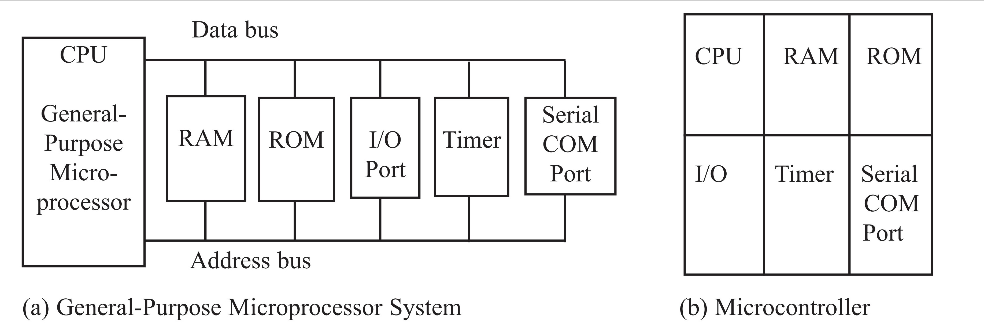
Figure 1-1. Microprocessor System Contrasted with Microcontroller System

Slide 6
Table 1-1: Some Embedded Products Using Microcontrollers
Home
Appliances
Intercom
Telephones
Security systems
Garage door openers
Answering machines
Fax machines
Home computers
TVs
Cable TV tuner
VCR
Camcorder
Remote controls
Video games
Cellular phones
Musical instruments
Sewing machines
Lighting control
Paging
Camera
Pinball machines
Toys
Exercise equipment

Slide 7
Table 1-1: Some Embedded Products Using Microcontrollers
Office
Telephones
Computers
Security systems
Fax machine
Microwave
Copier
Laser printer
Color printer
Paging
Auto
Trip computer
Engine control
Air bag
ABS
Instrumentation
Security system
Transmission control
Entertainment
Climate control
Cellular phone
Keyless entry

Slide 8
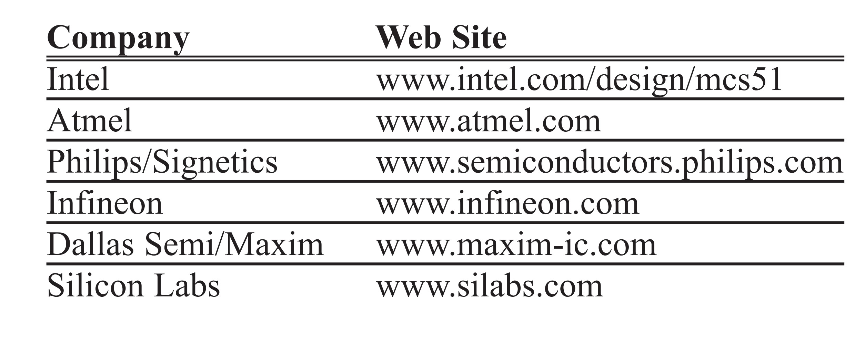
Table 1-2: Some of the Companies Producing a Member of the 8051 Family

Slide 9
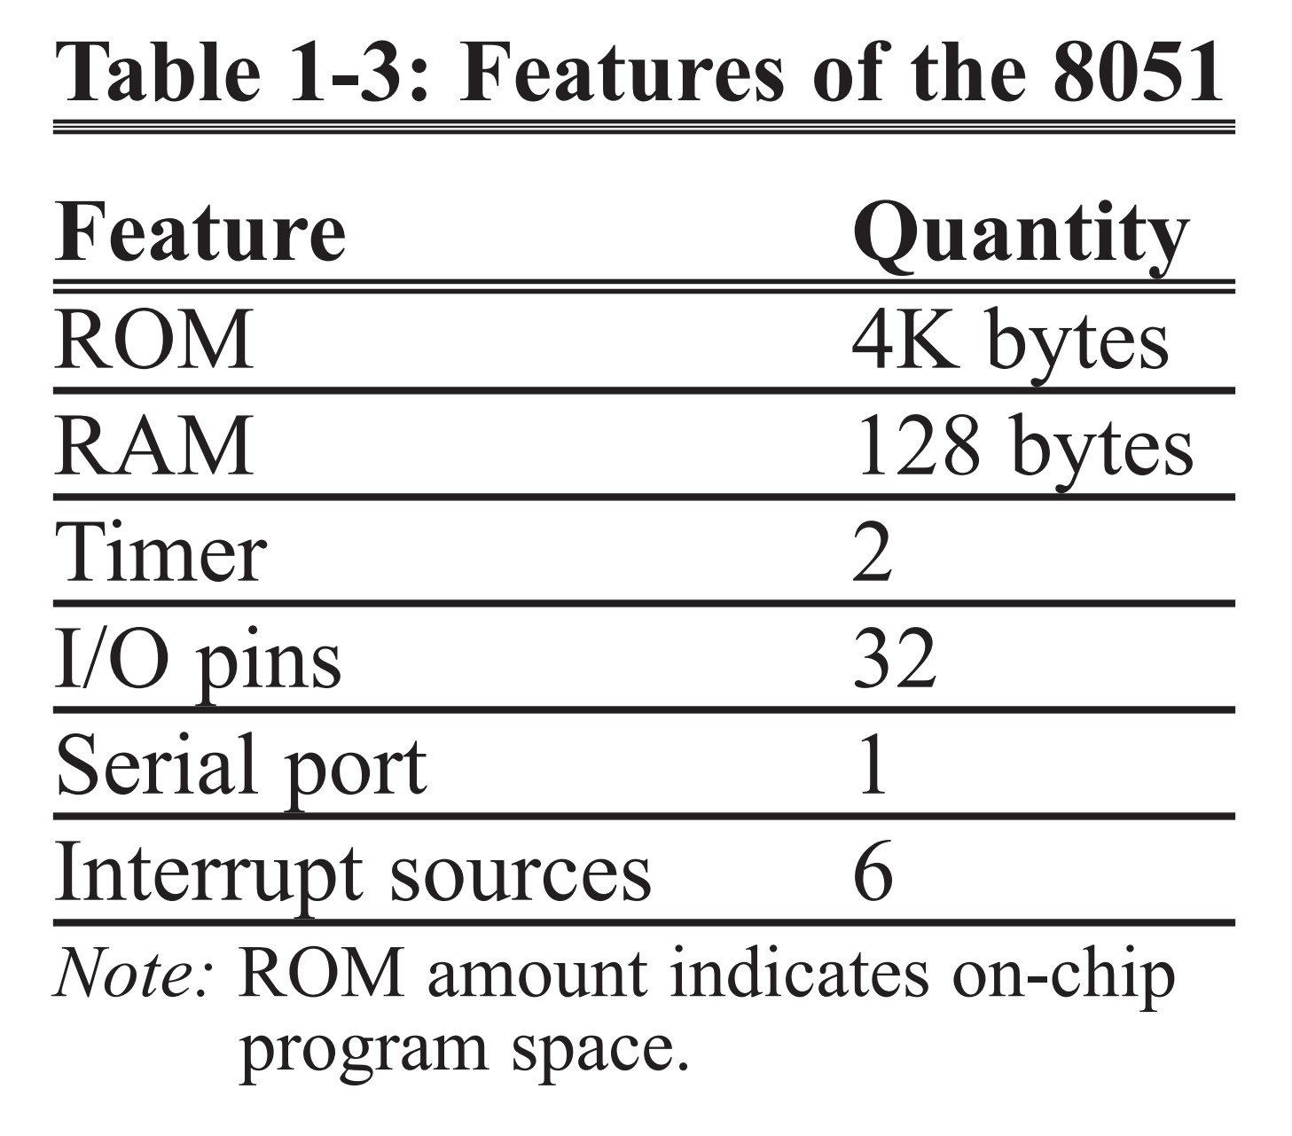
Overview of the 8051 Family

Slide 10
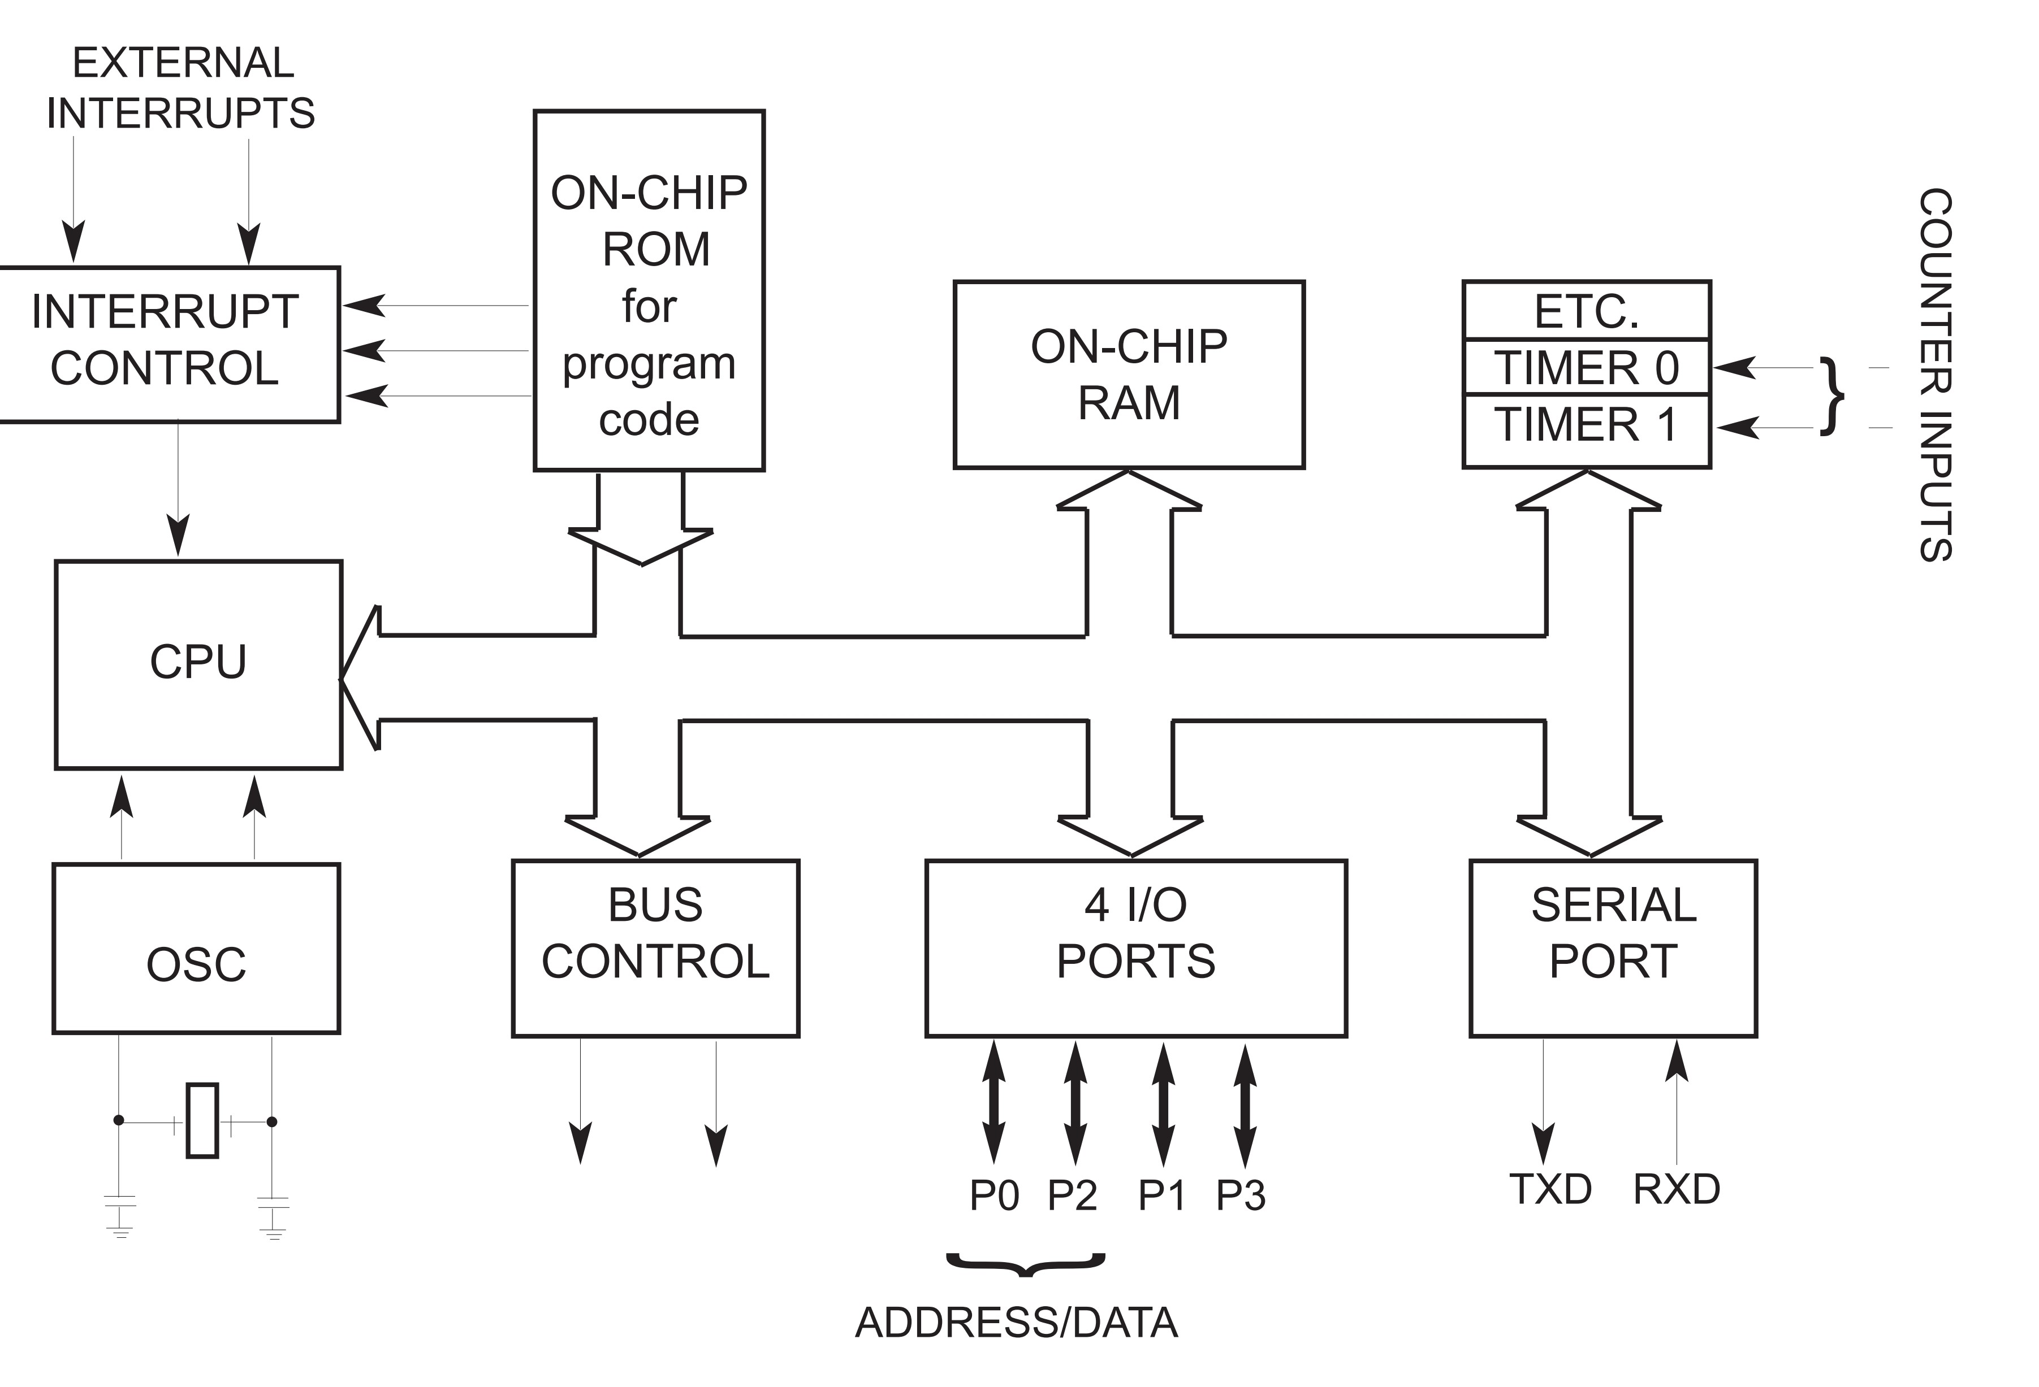
Figure 1-2. Inside the 8051 Microcontroller Block Diagram

Slide 11
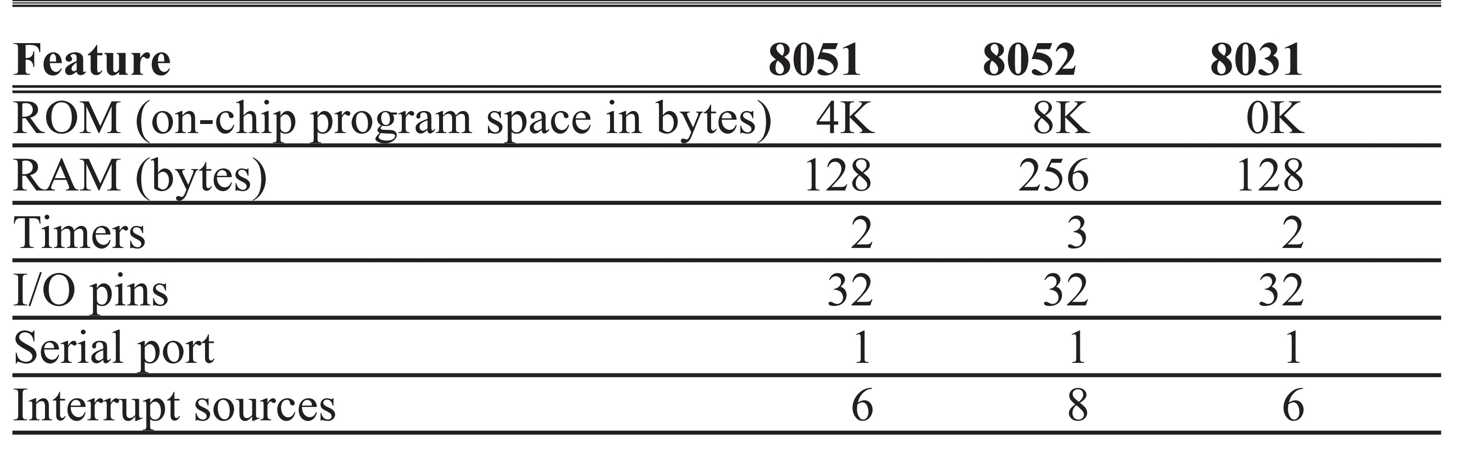
Table 1-4: Comparison of 8051 Family Members

Slide 12
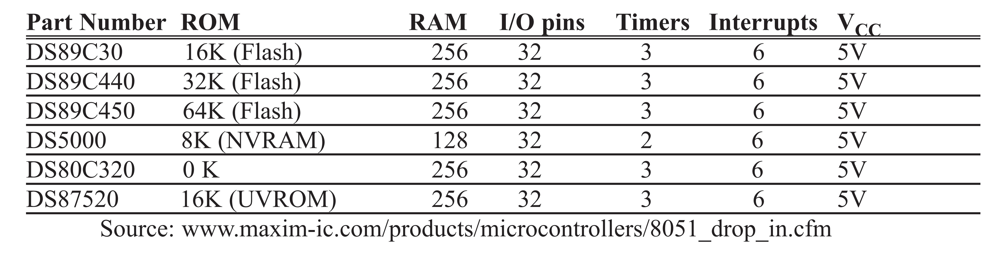
Table 1-5: Versions of 8051/52 Microcontroller from Dallas Semiconductor (Maxim)
For a DS89C4x0-based trainer see www.MicroDigitalEd.com.
For a SiLabs trainer tutorial see www.MicroDigitalEd.com.

Slide 13
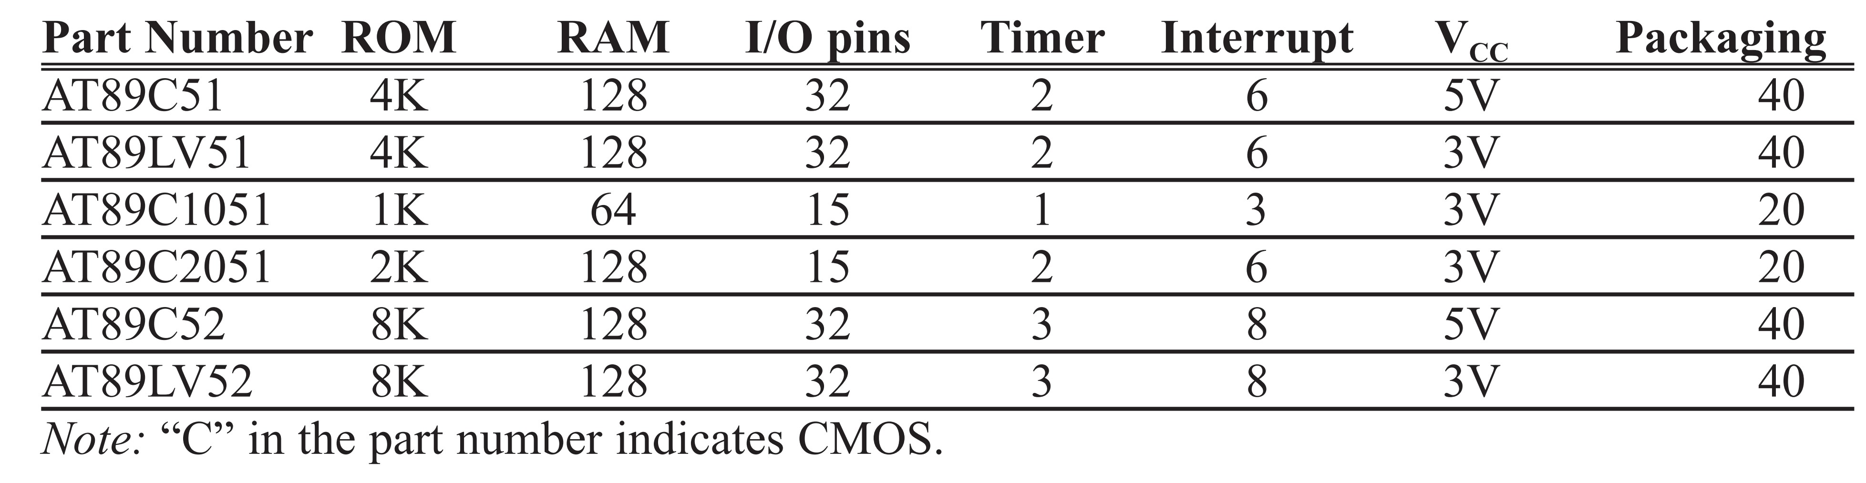
Table 1-6: Versions of 8051 from Atmel (All ROM Flash)

Slide 14
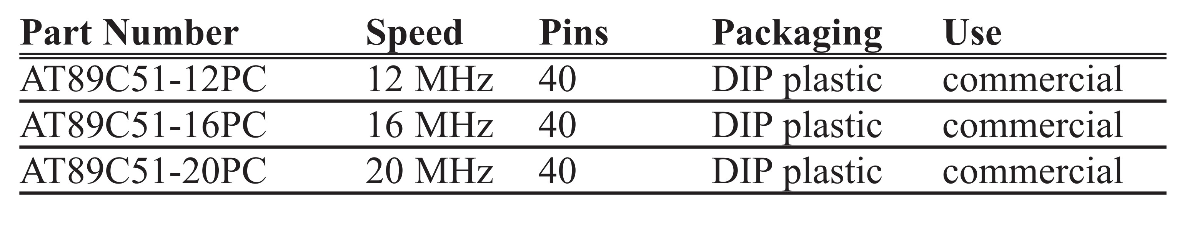
Table 1-7: Various Speeds of 8051 from Atmel

Slide 15
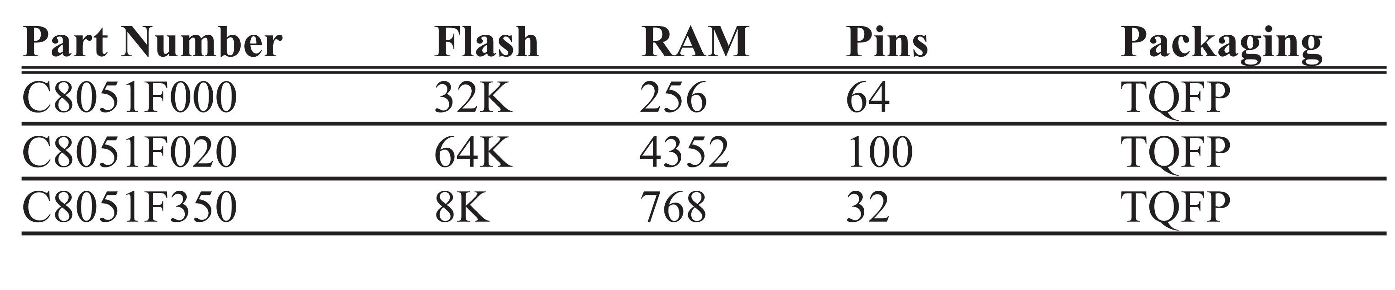
Table 1-8: The 8051 Chips from Silicon Labs (www.SiLabs.com)
See the following Web sites for 8051 products and their features from various companies:
www.8052.com/chips.phtml
www.MicroDigitalEd.com

